Slide 1
Value Optimizing Thru Dia-tomography-s
39.59 Ct Rough

Slide 2
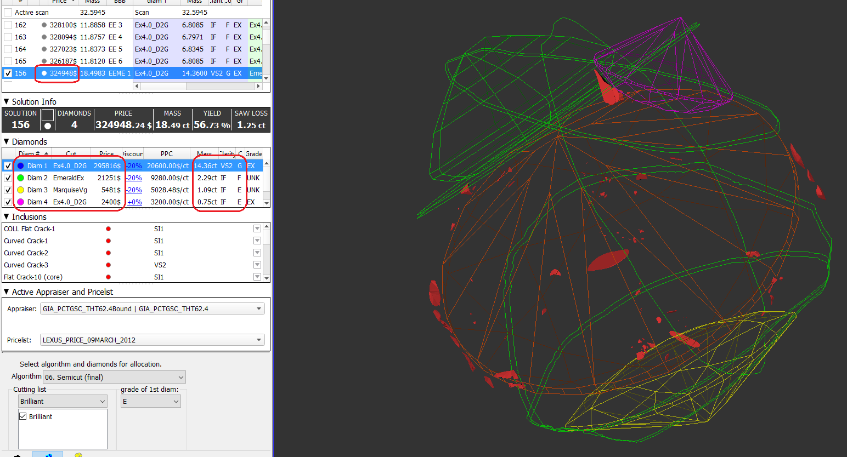
Executed solution

Slide 3
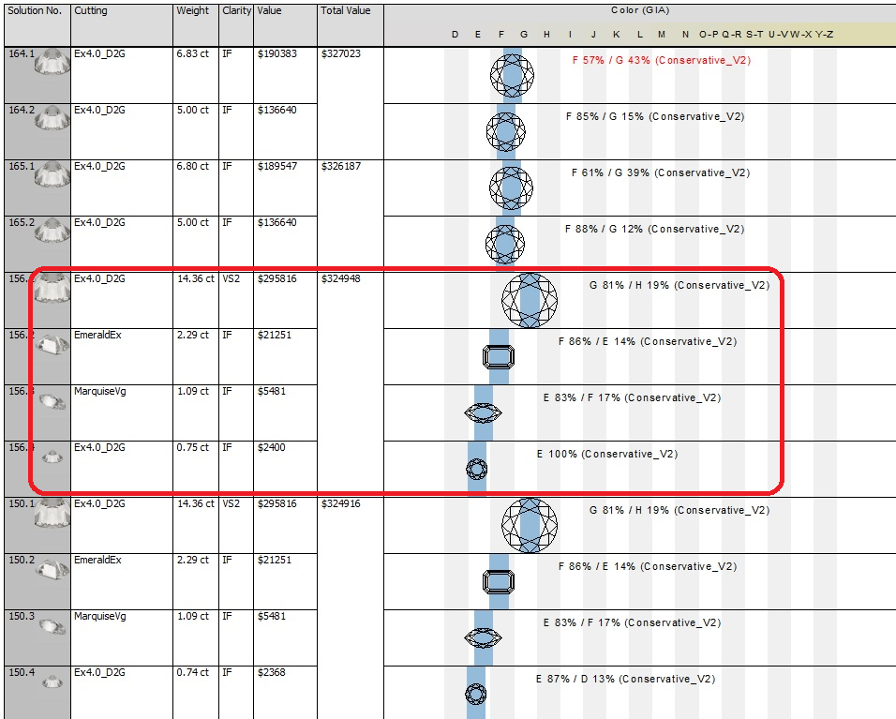

Slide 4
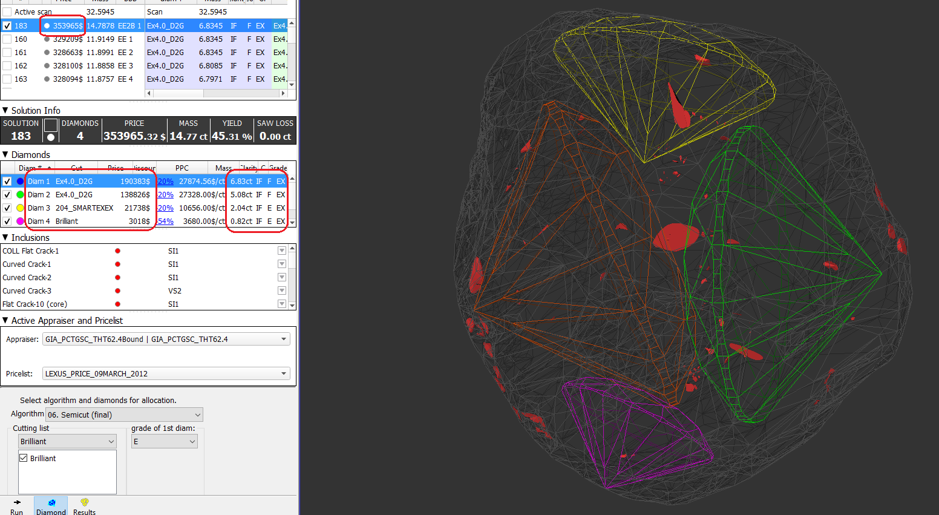
Alternate plan

Slide 5
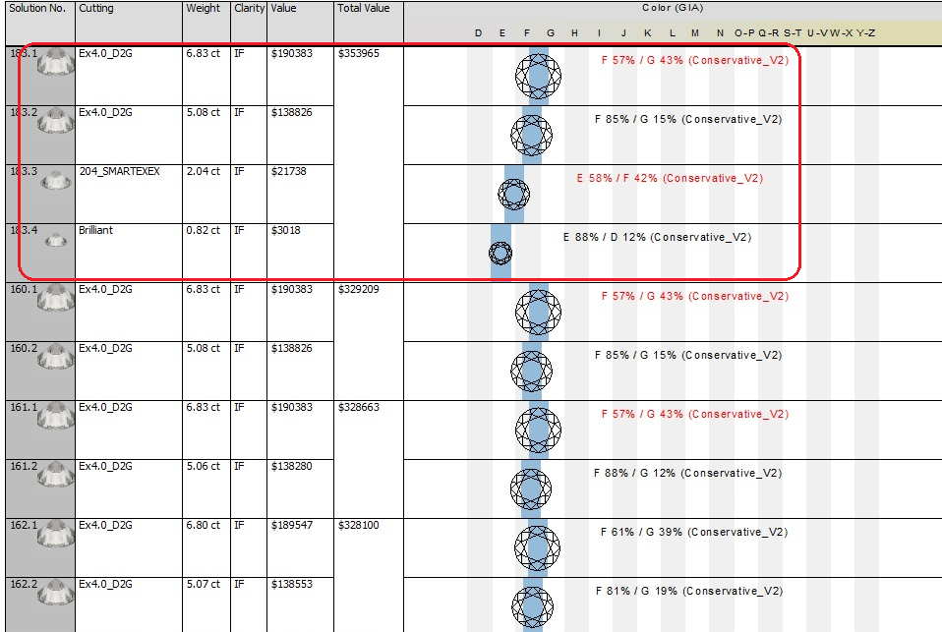

Slide 6
DZ GAIN (8.9%)
RBC | 0.83 | E-IF | 3017
$ 29017
RBC | 2.04 | E-IF | 21738
RBC | 0.75 | E-IF | 2400
Marquise | 1.09 | E-IF | 5481
Emerald | 2.29 | F-IF | 21251
RBC | 5.08 | E-IF | 138826
RBC | 14.36 | G-VS2 | 295816
RBC | 6.83 | F-IF | 190383
Executed Plan
Alternate plan

