Slide 1
Re-Imagineering (Cushion)
2.00 Ct Cushion

Slide 2
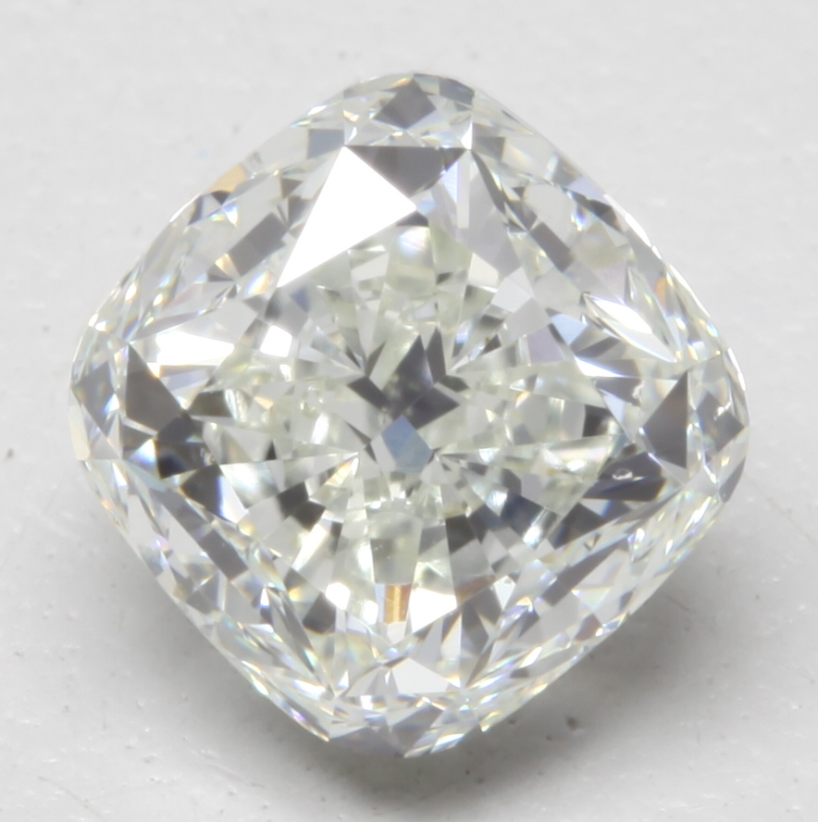
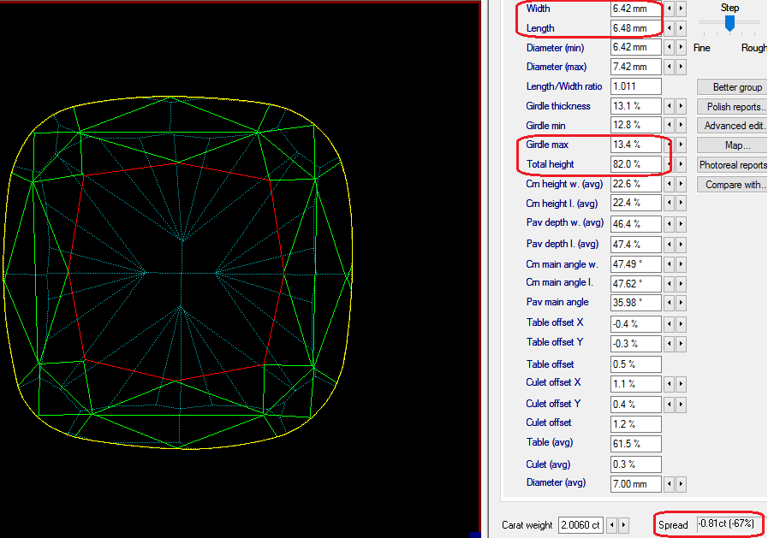
Original Polish – 2.00 Ct (I-VS2) (IGI H-VS2) Spread -67%

Slide 3
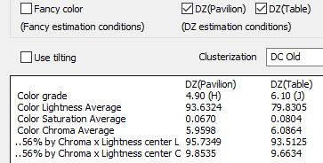
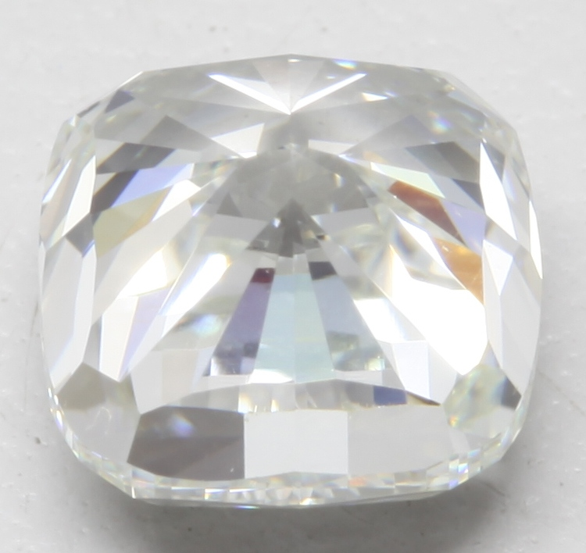
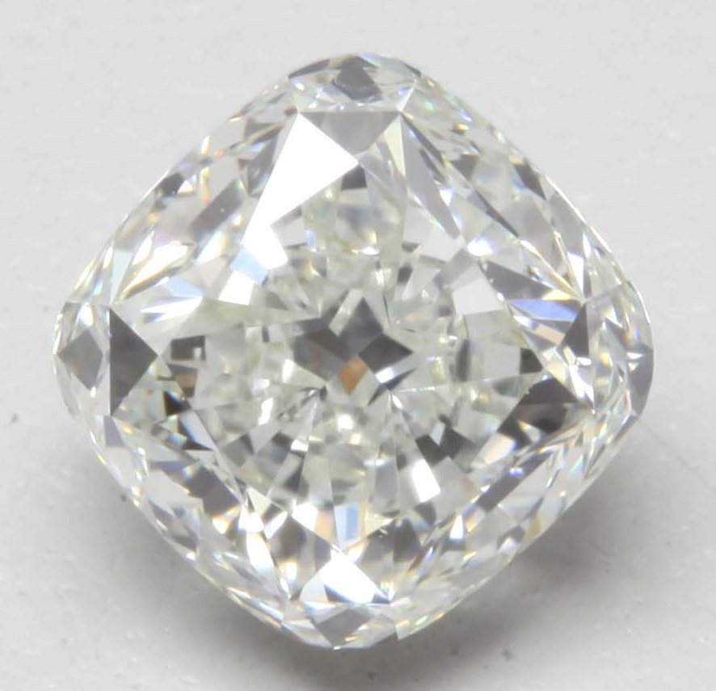

Slide 4
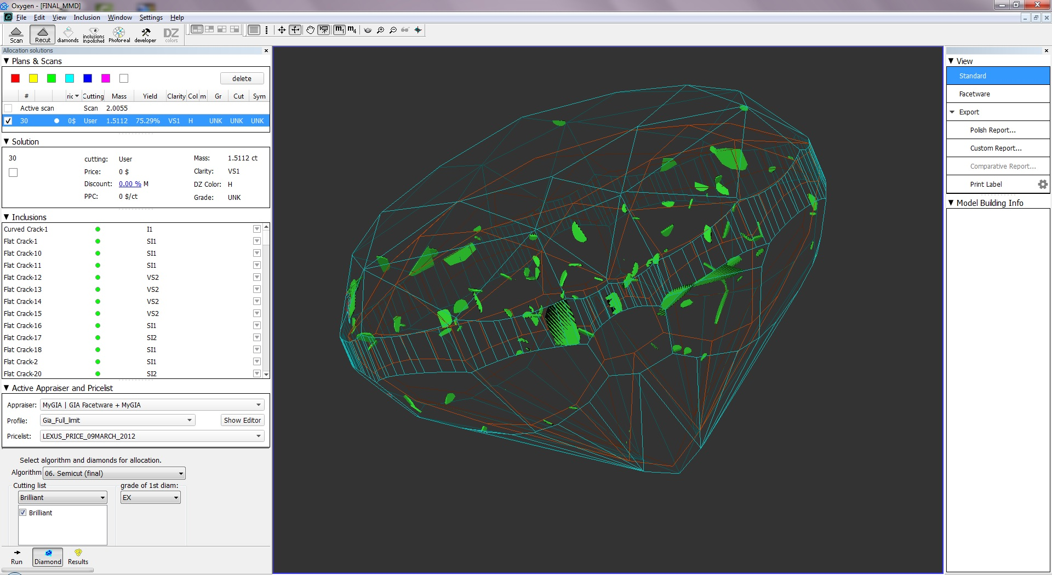

Slide 5
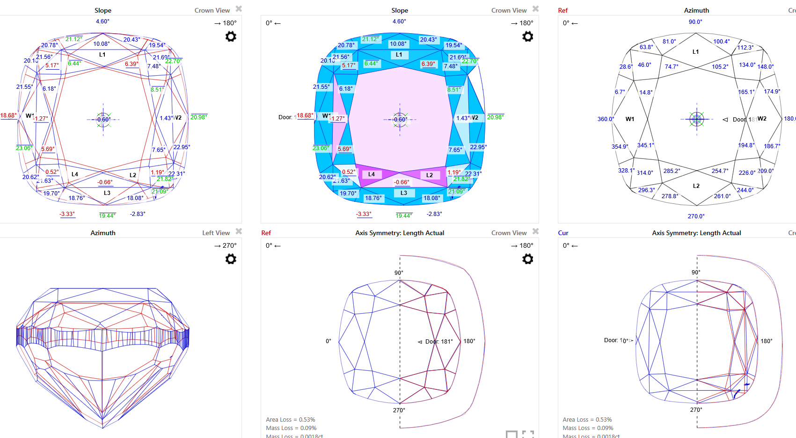
Re-Imagineering interactive 3D Report

Slide 6
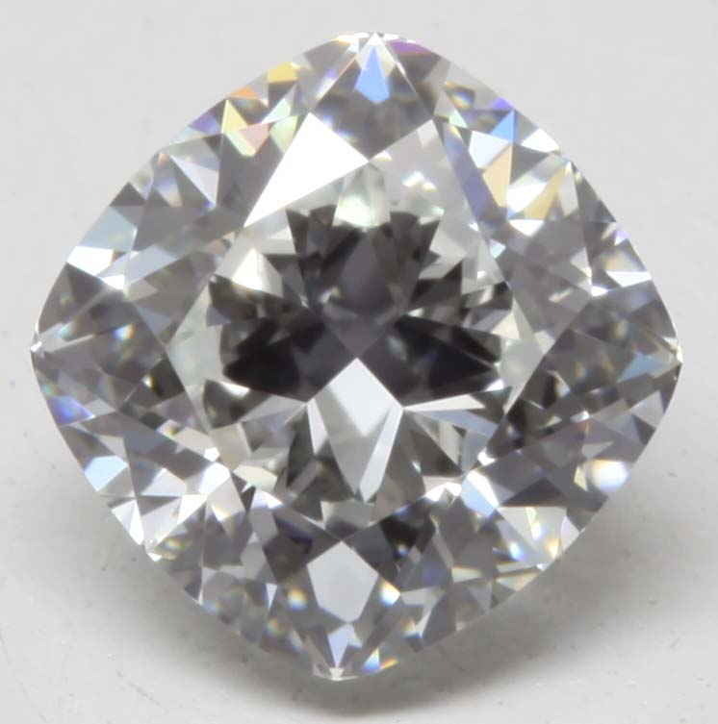
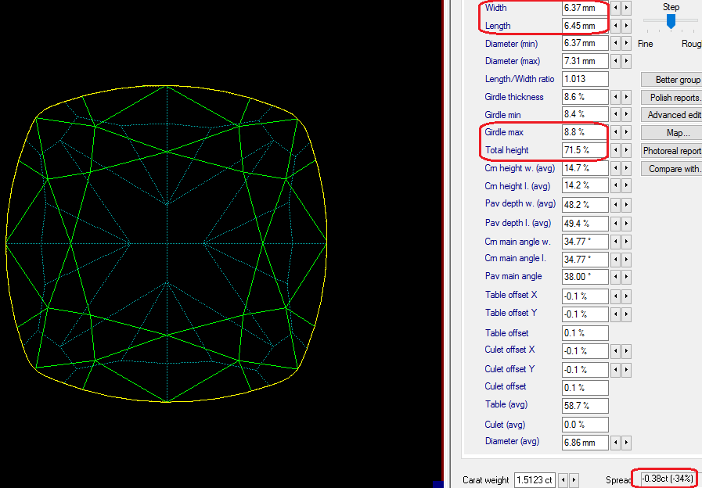
Recut Polish – 1.51 Ct (H-VS1) Spread -34%

Slide 7
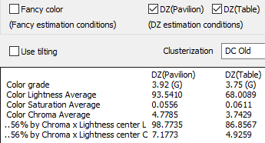
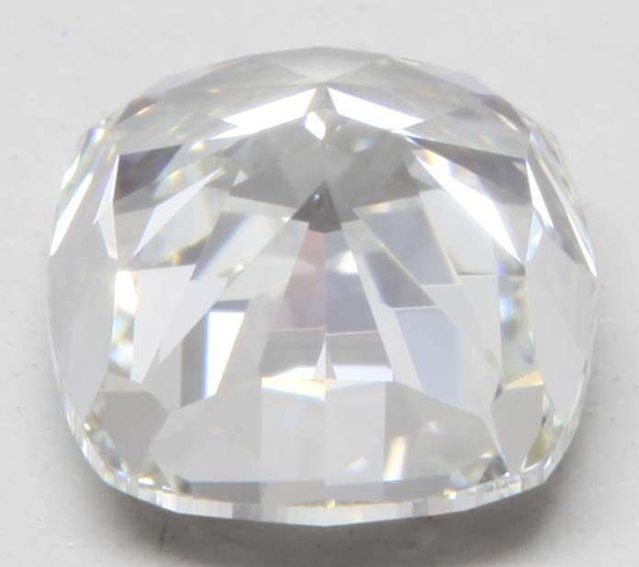

Slide 8
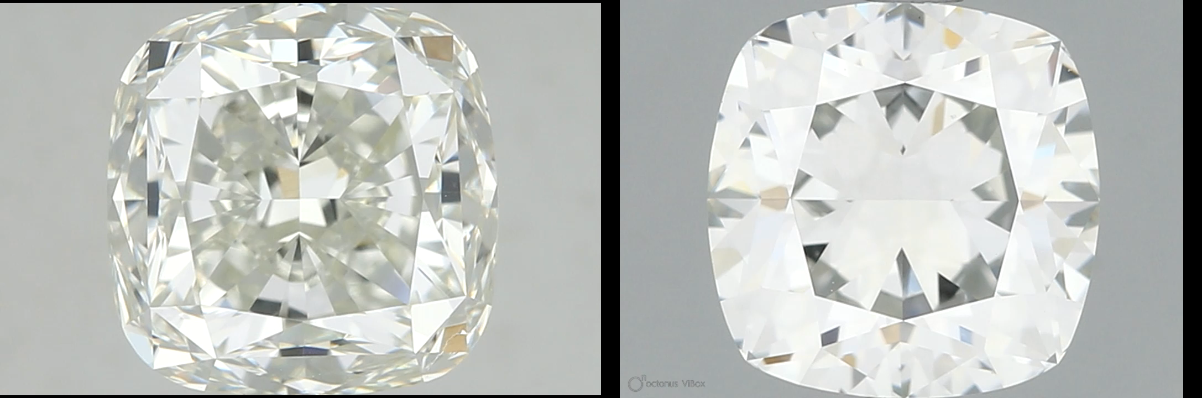

Slide 9
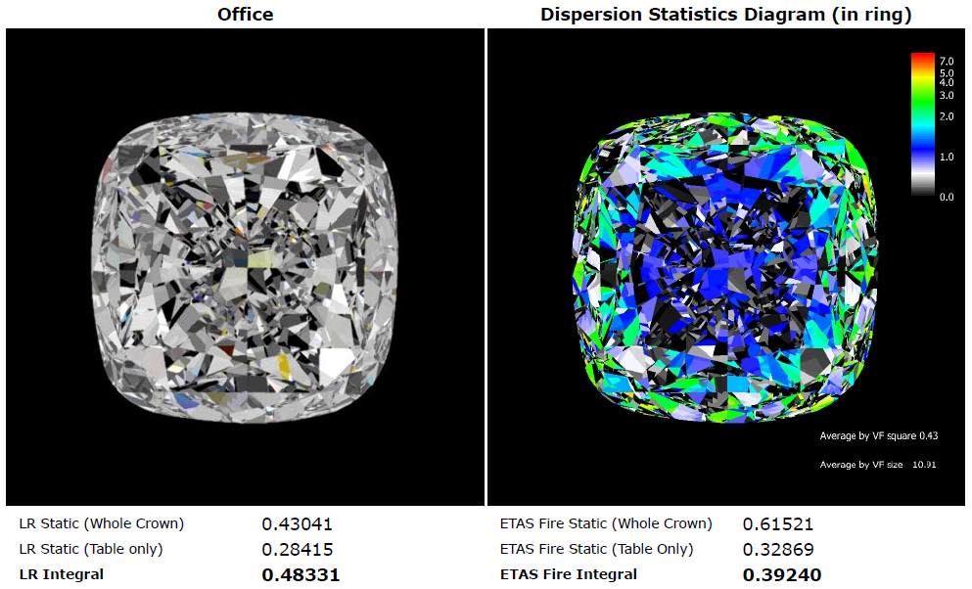

Slide 10
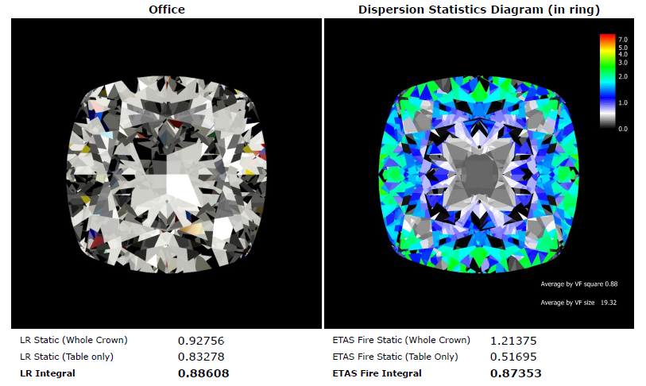

Slide 11
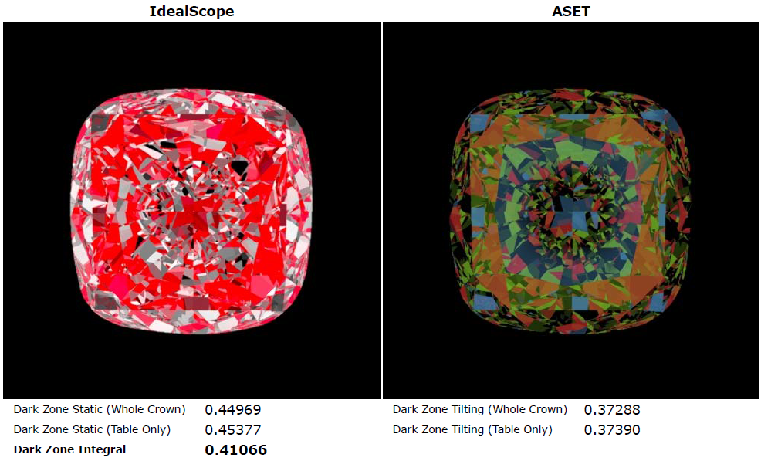

Slide 12
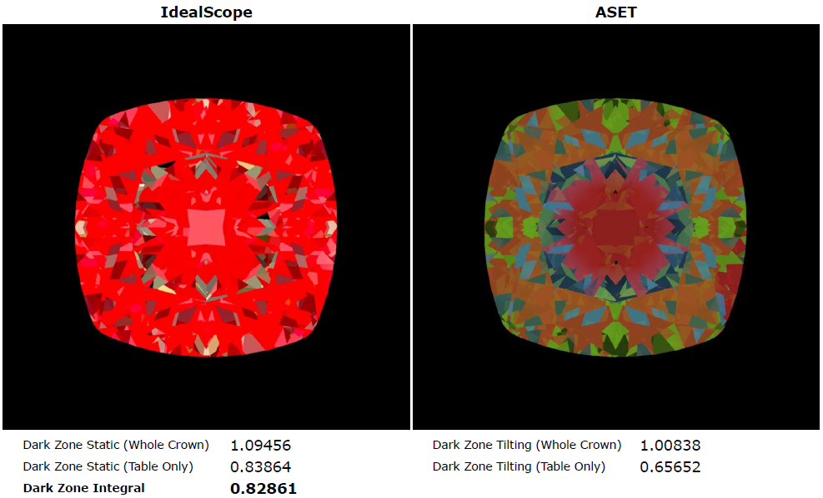

Slide 13
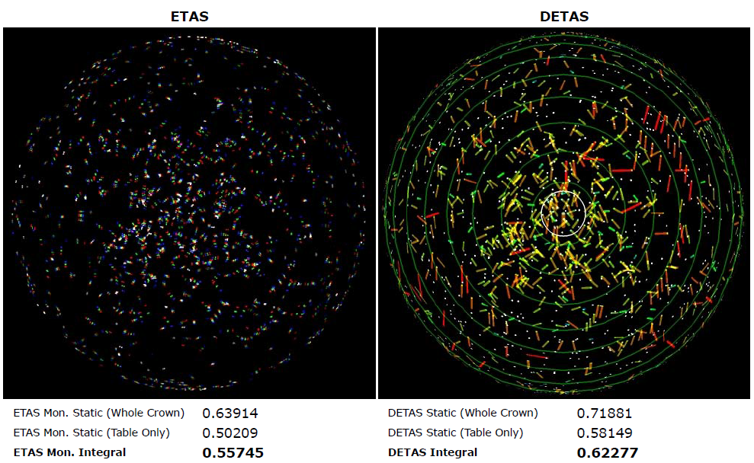

Slide 14
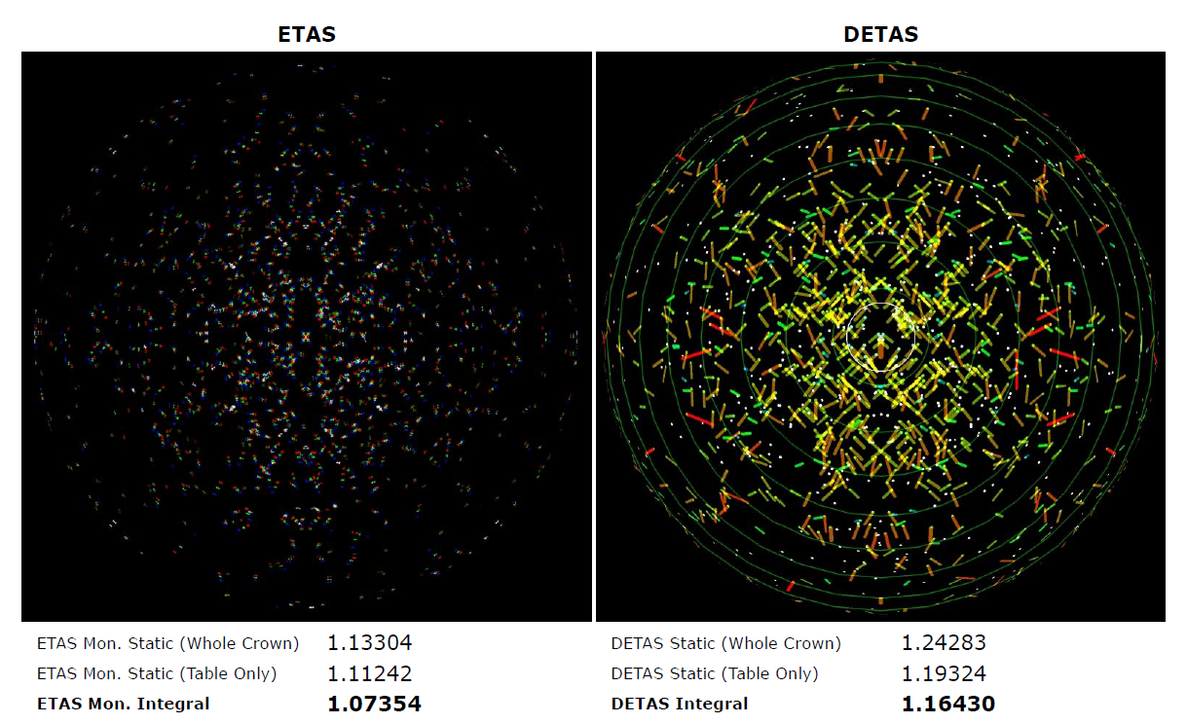

Slide 15
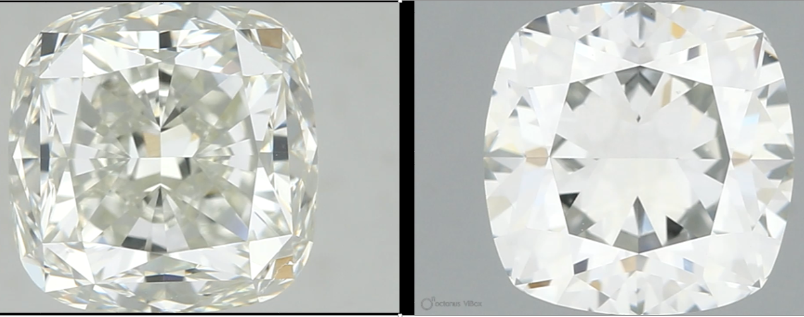
Value gain = $3204 (44.5%)
2.00 Ct – H-VS2 (IGI) [I-VS2 (GIA)]
Size: 6.42 x 6.48 x 5.26 (82%)
Spread = -67% (face up size equivalent to 1.19 Ct RBC)
Rap price – $9700 / ct [$ 8000 / ct]
Price = $ 7178 (-63% back) [$ 7200 / ct (-55% back)]
1.51 Ct – F-VVS2 (GIA)
Size: 6.37 x 6.45 x 4.55 (71.5%)
Spread = -34% (face up size equivalent to 1.14 Ct RBC)
Rap price – $10600 / ct
Price = $ 10404 (-35% back)

